Slide 1
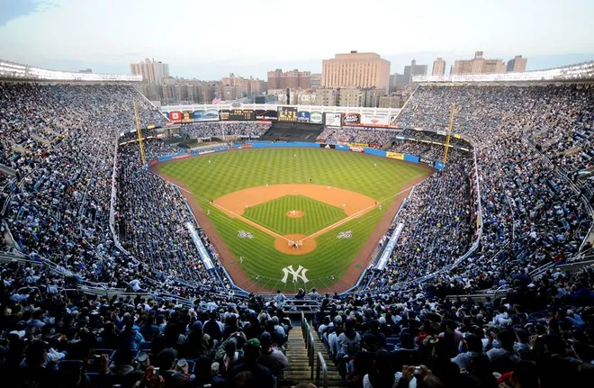
Notes:
Yankee Stadium

Slide 2
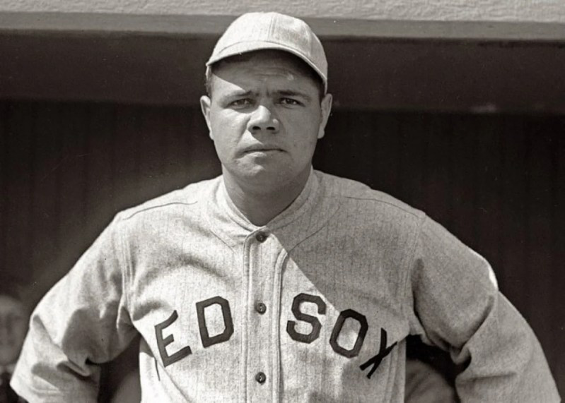
Notes:
Babe Ruth

Slide 3
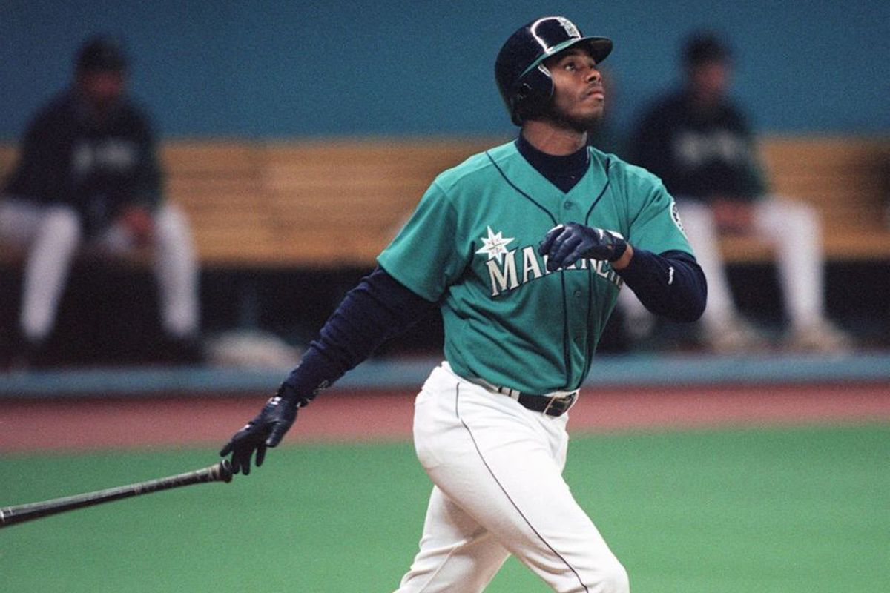
Notes:
Ken Griffey Jr

Slide 4
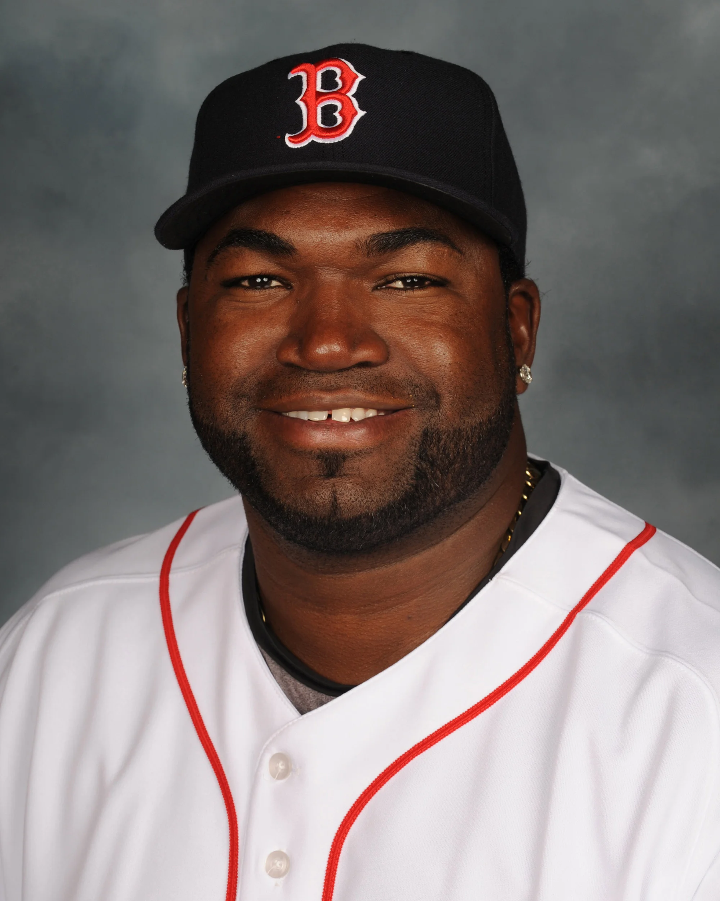
Notes:
David Ortiz (“Big Papi”)

Slide 5
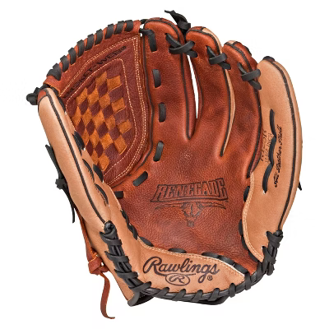
Notes:
Baseball glove

Slide 6
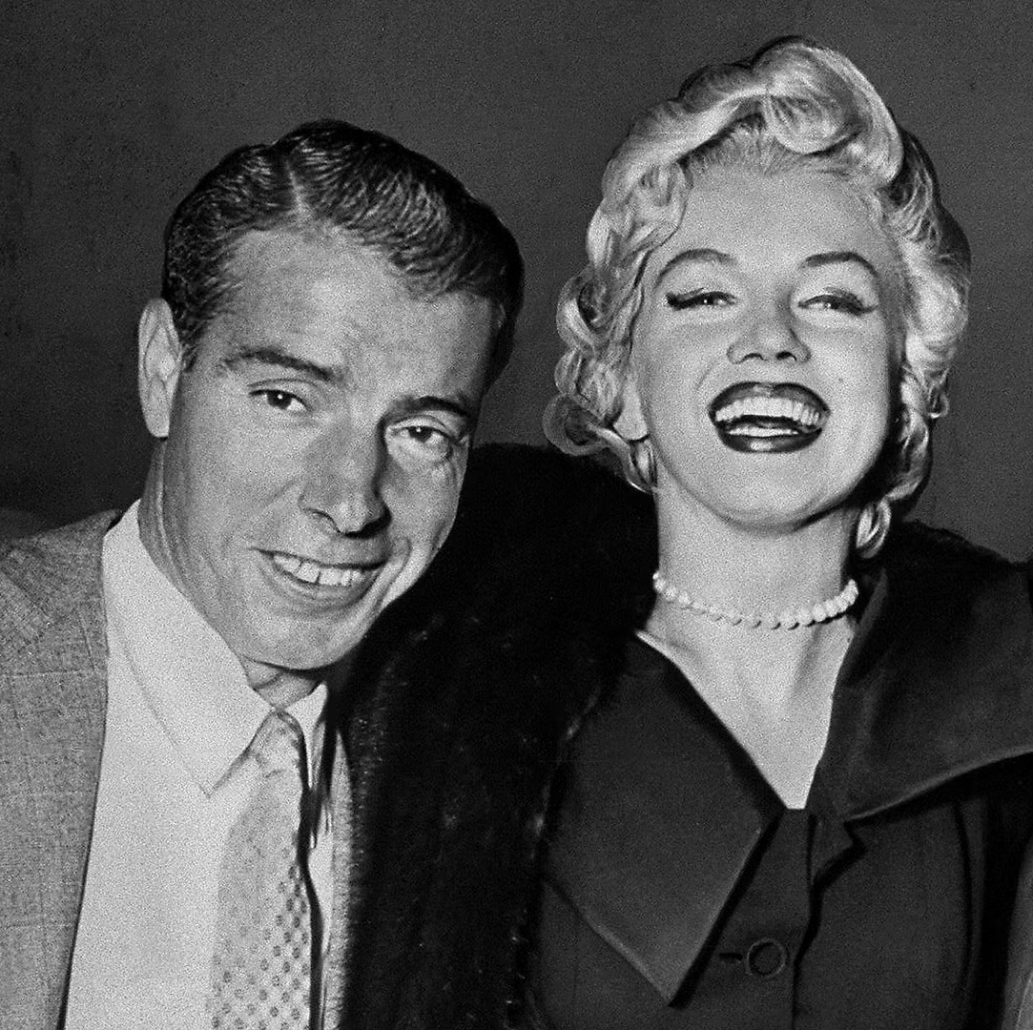
Notes:
Joe Dimmagio

Slide 7
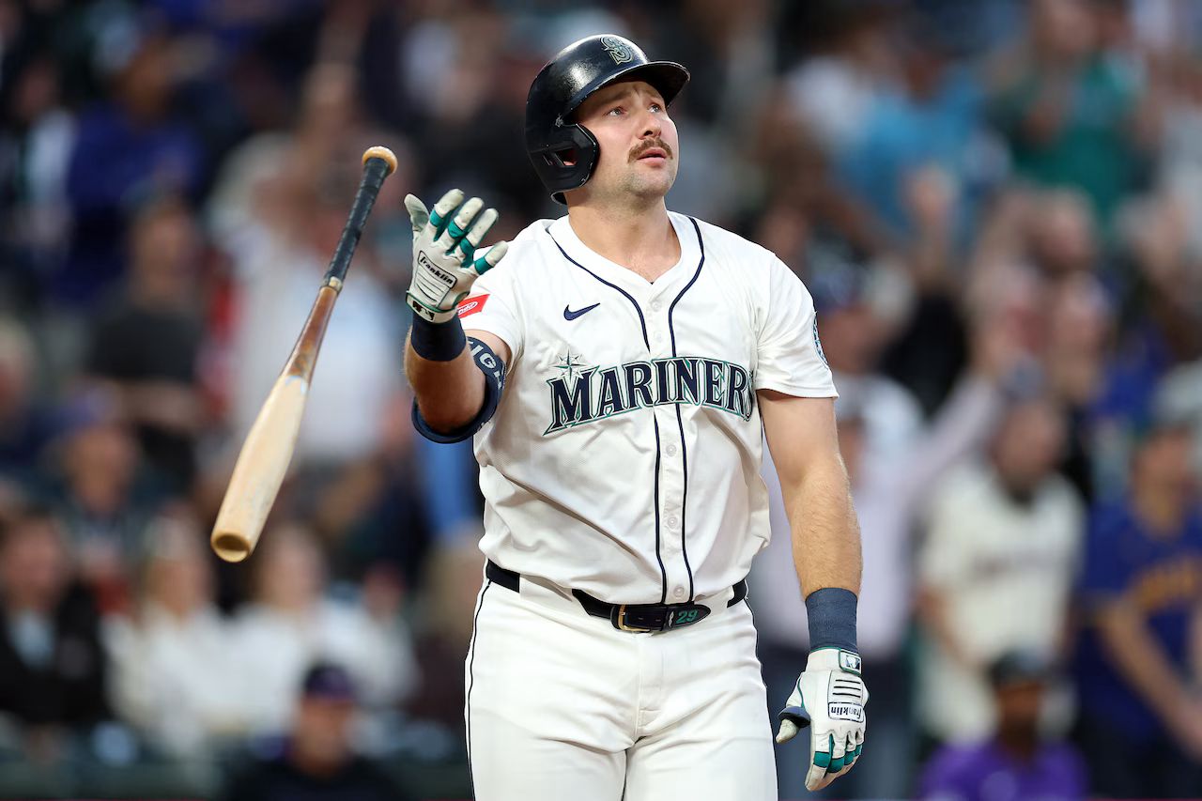
Notes:
Cal Raleigh

Slide 8
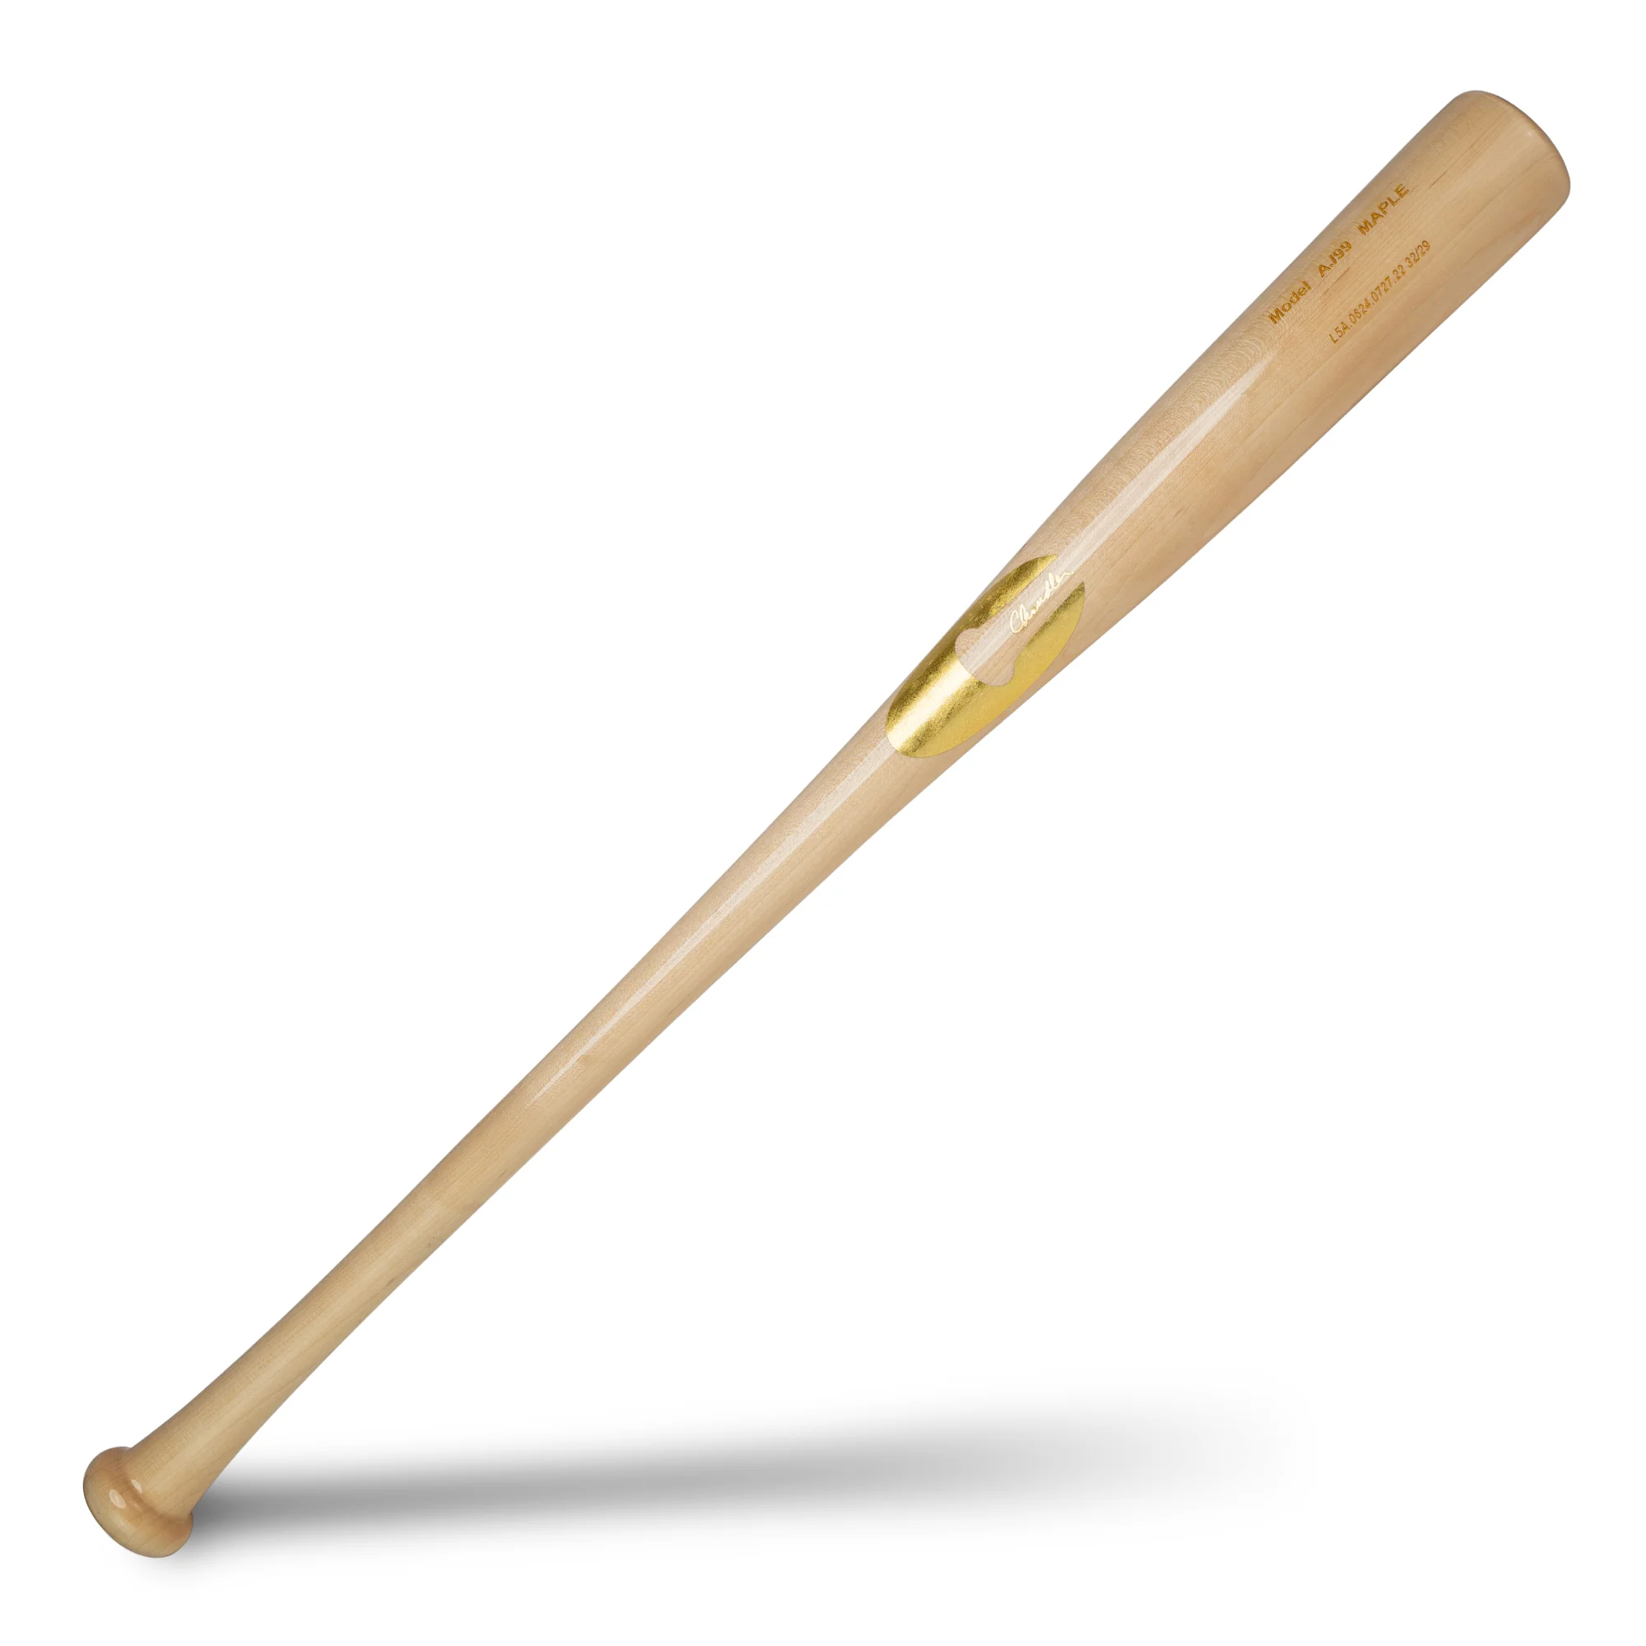
Notes:
Baseball bat

Slide 9
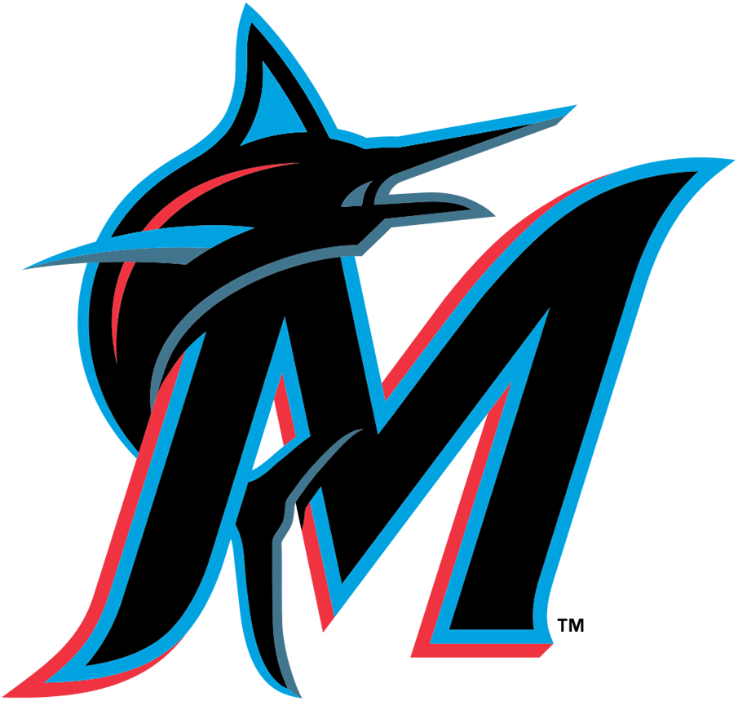
Notes:
Miami Marlins

Slide 10
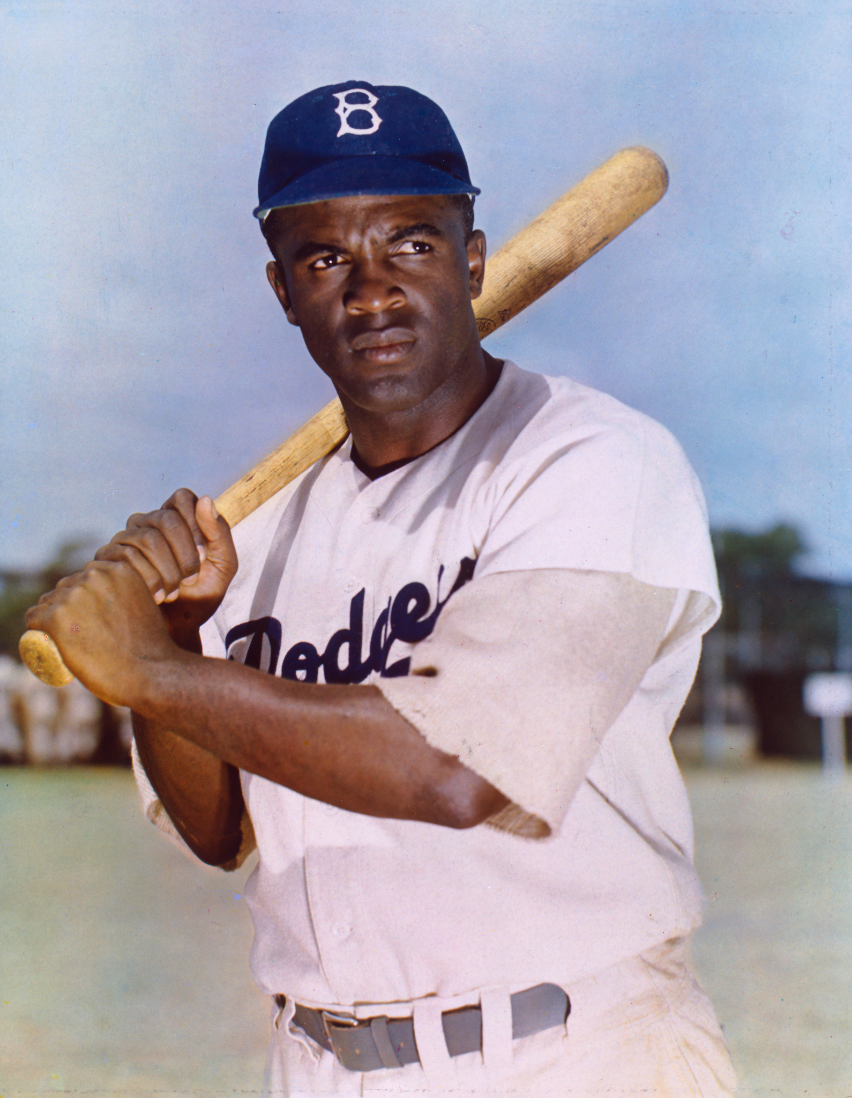
Notes:
Jackie Robinson

Slide 11
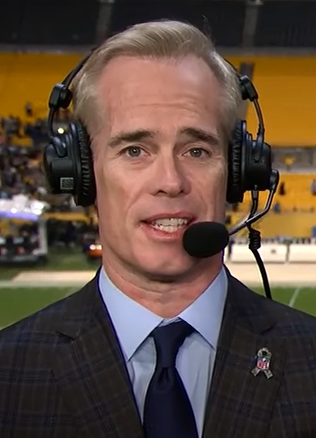
Notes:
Joe Buck

Slide 12
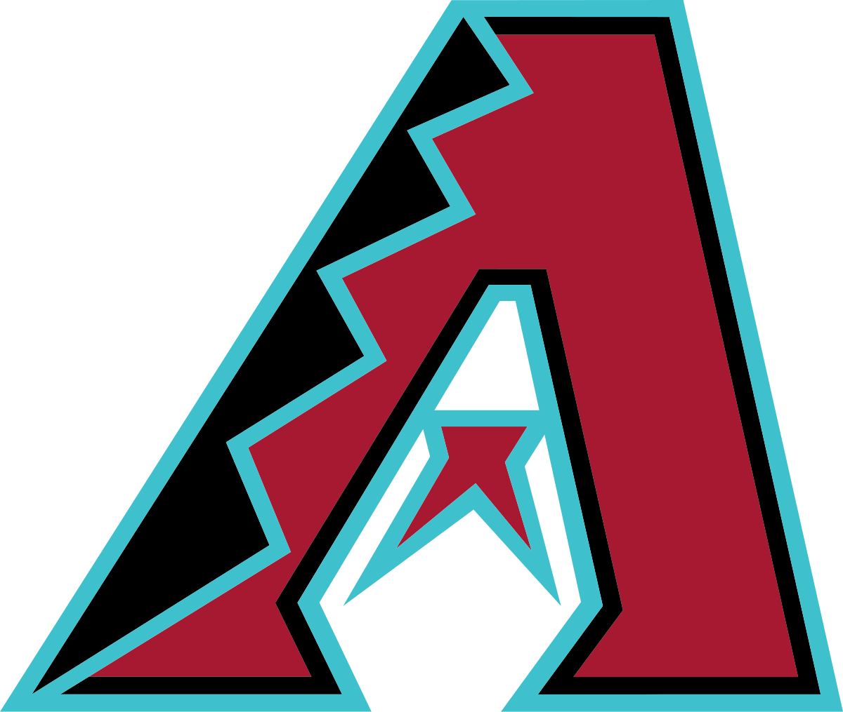
Notes:
Arizona Diamondbacks

Slide 13
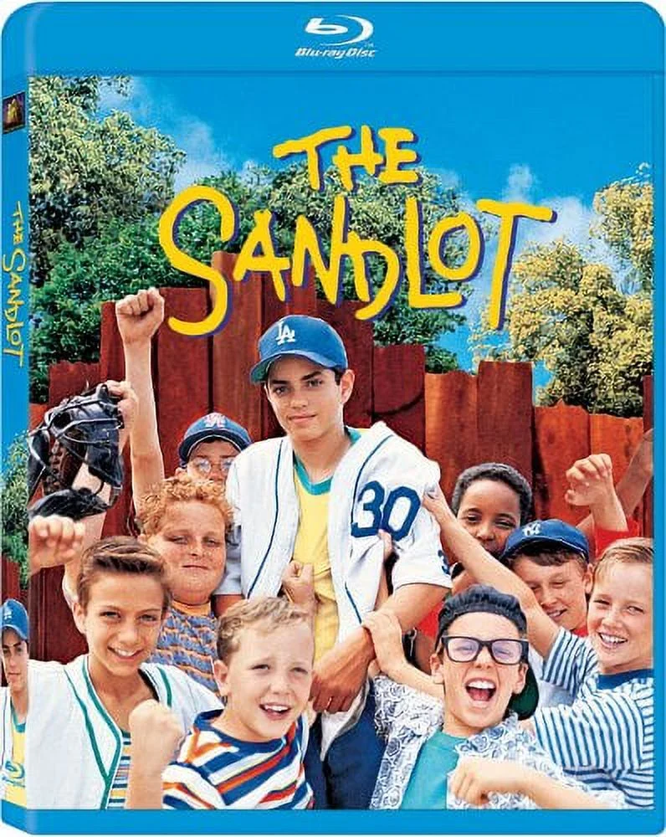
Notes:
The Sandlot

Slide 14
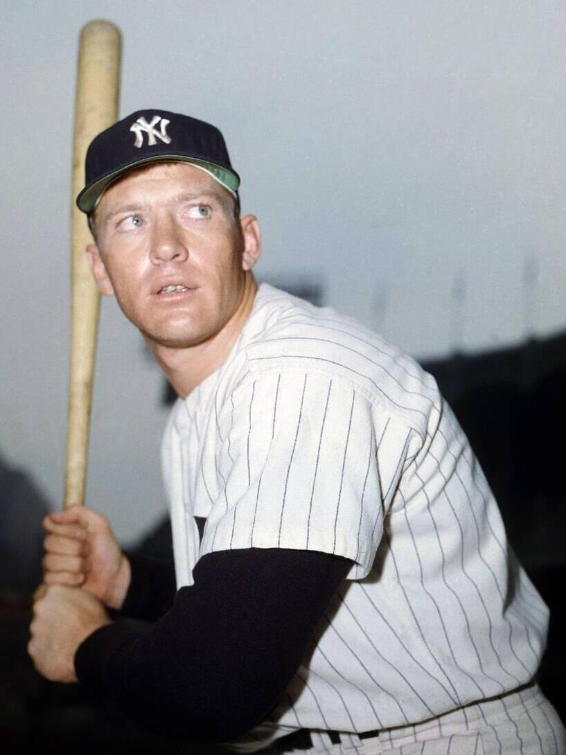
Notes:
Mickey Mantle

Slide 15
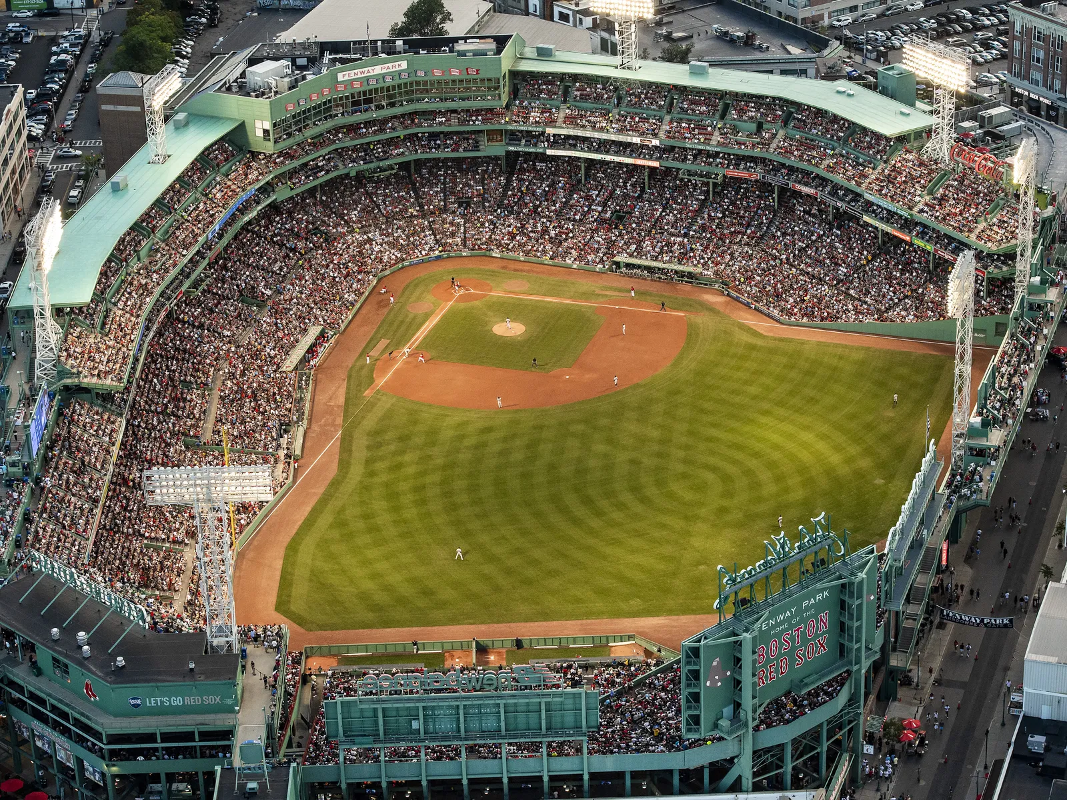
Notes:
Fenway Park

Slide 16
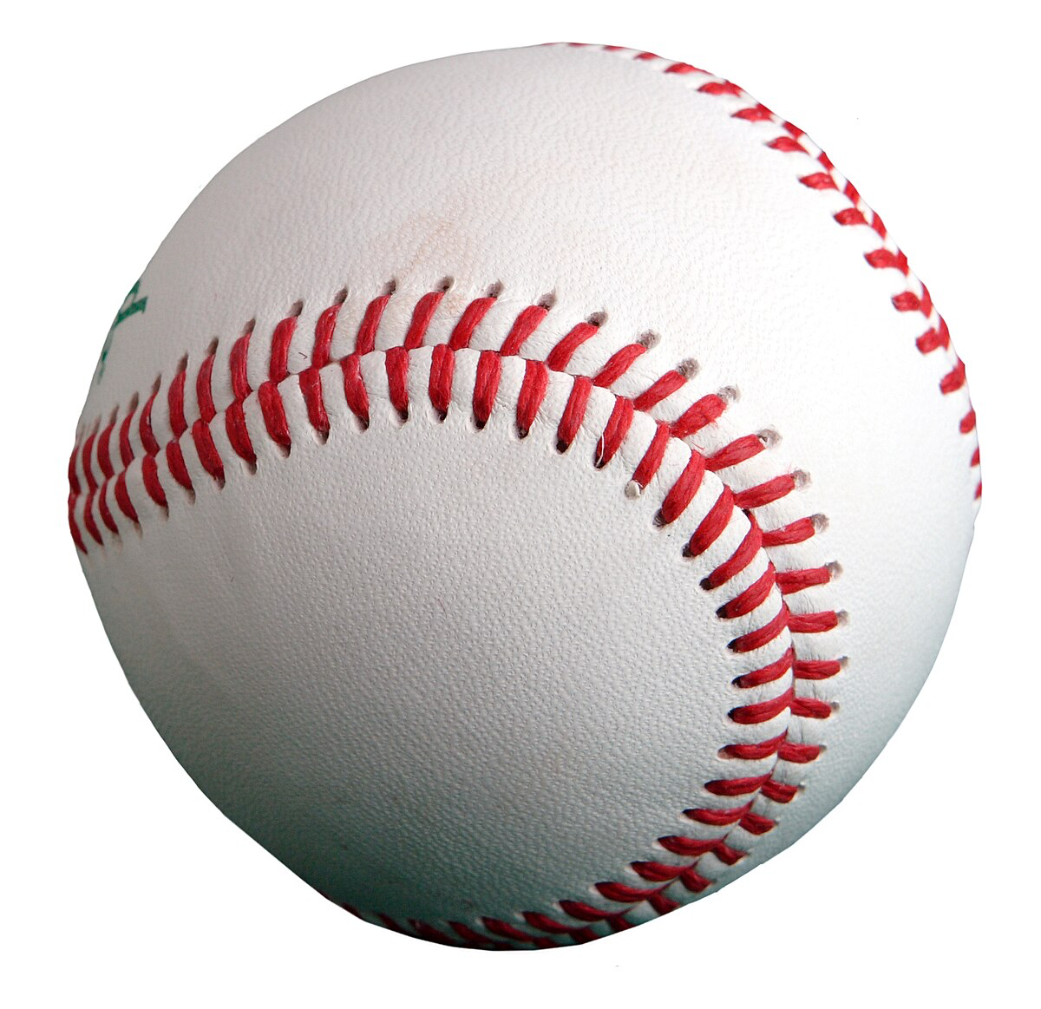
Notes:
baseball

Slide 17


Slide 18
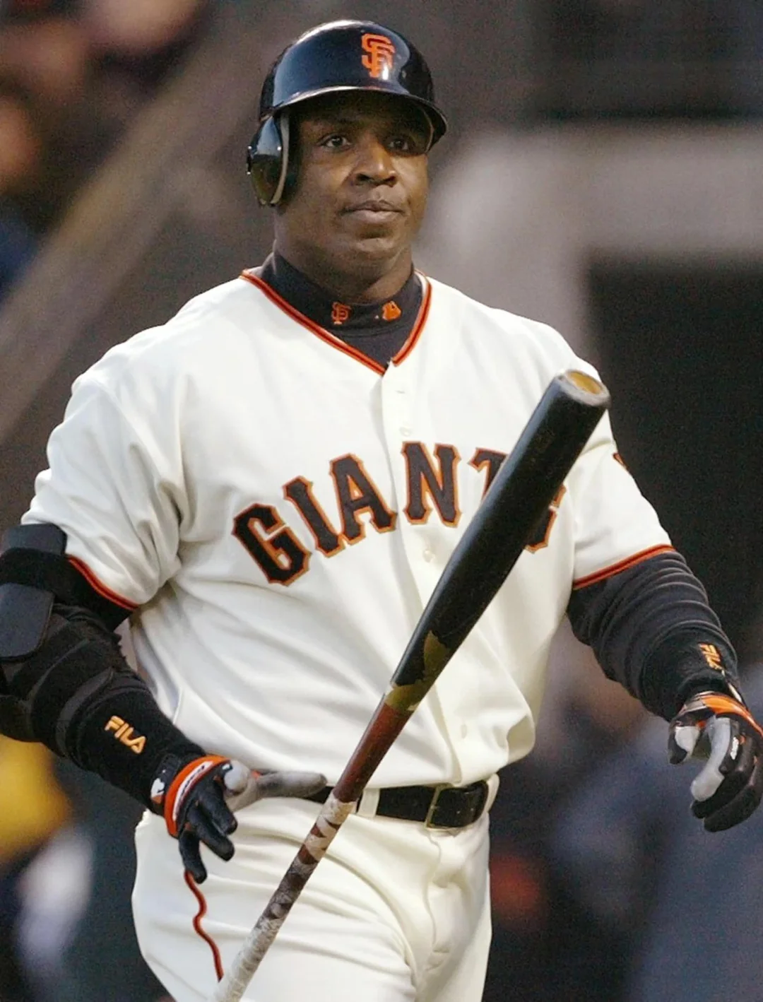
Notes:
Barry Bonds

Slide 19
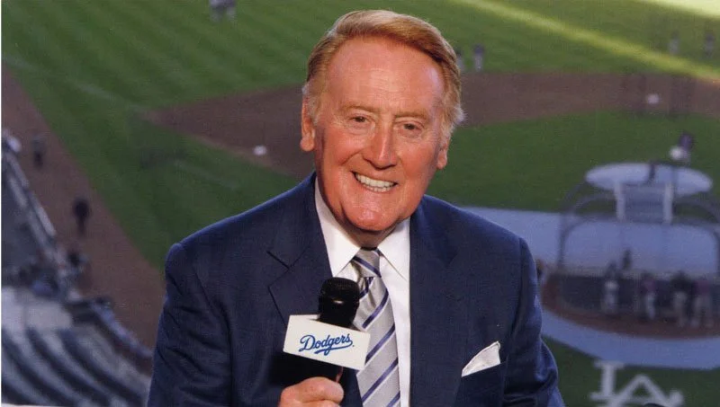
Notes:
Vin Scully

Slide 20

Notes:
Minnesota Twins

Slide 21
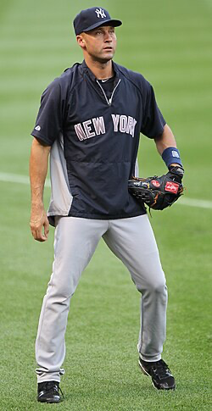
Notes:
Derek Jeter

Slide 22
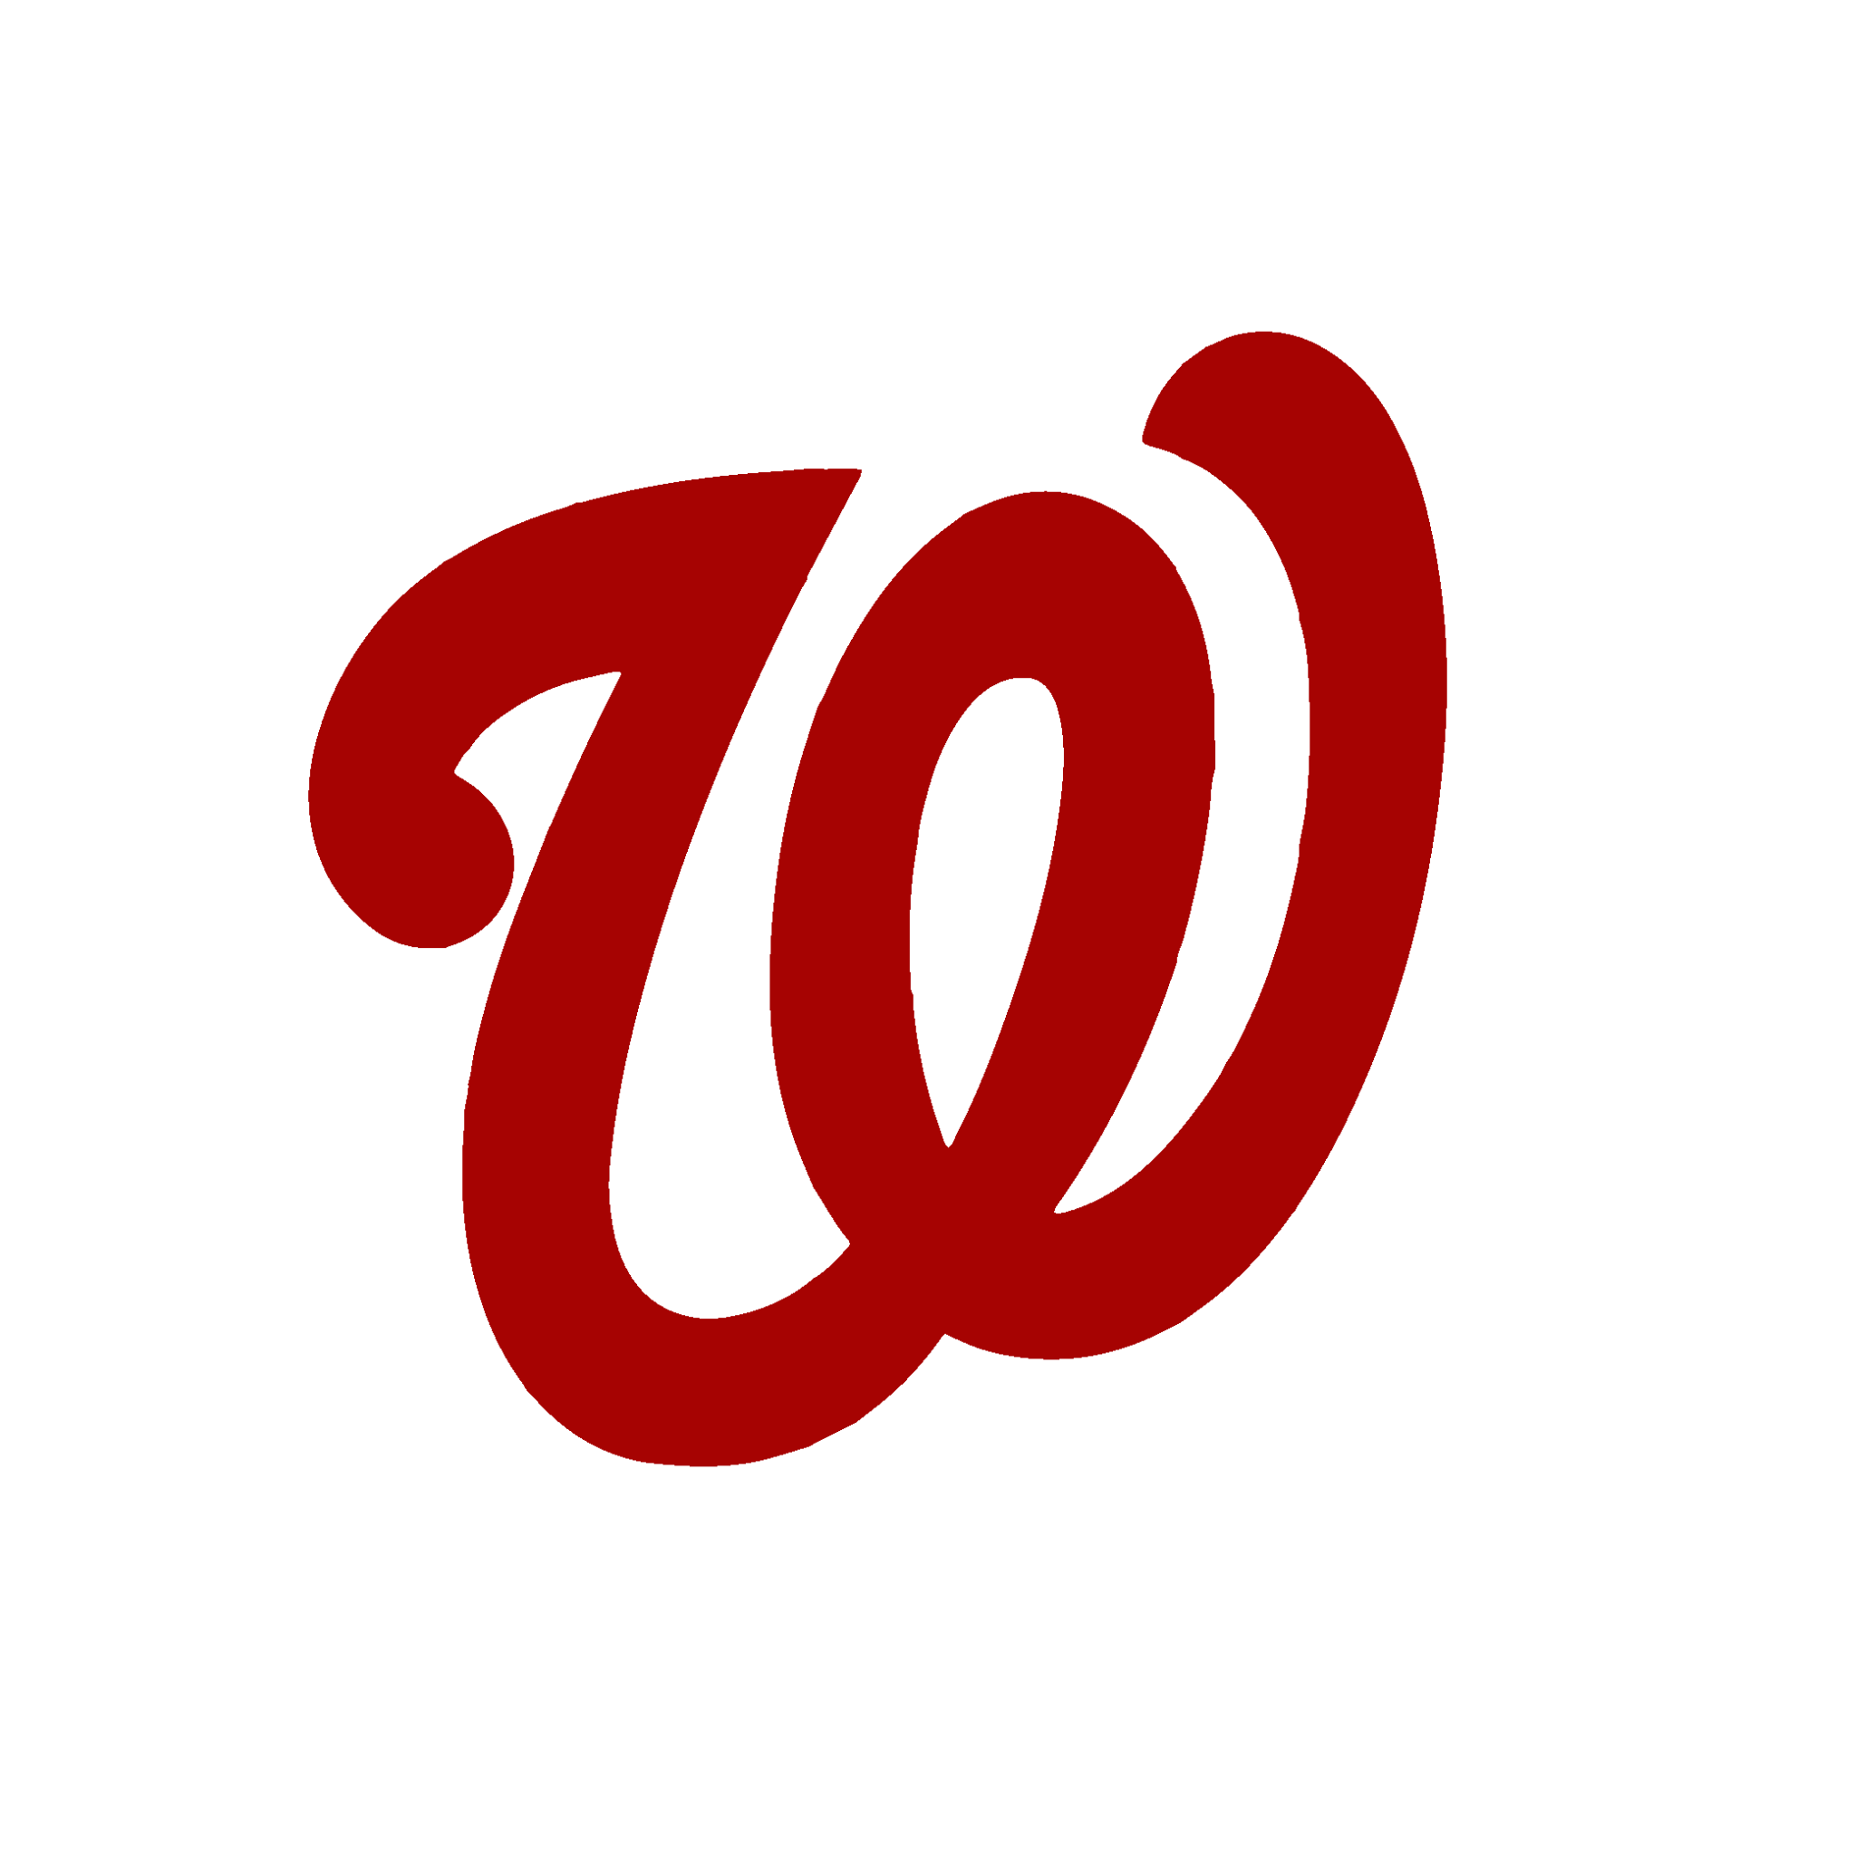
Notes:
Washington Nationals

Slide 23
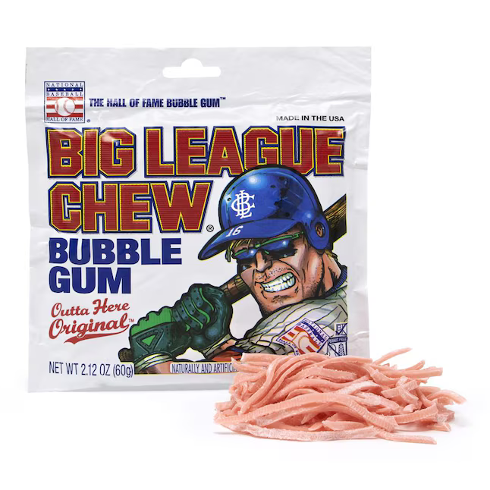
Notes:
Big League Chew

Slide 24
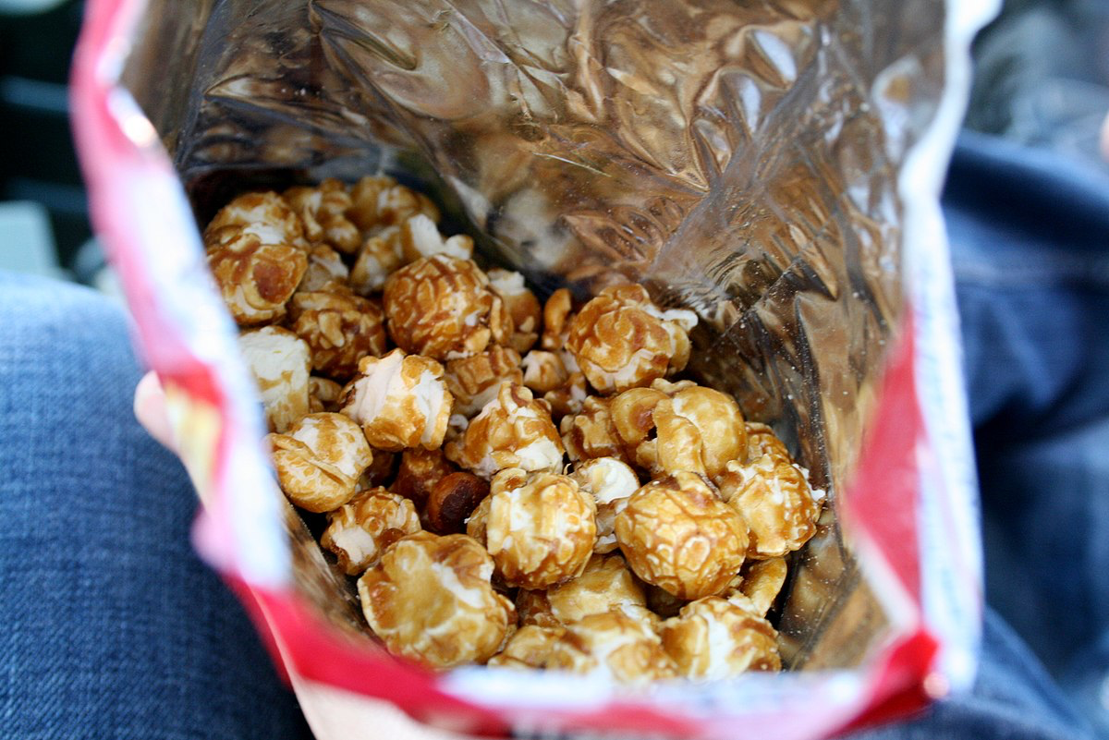
Notes:
crackerjack

Slide 25
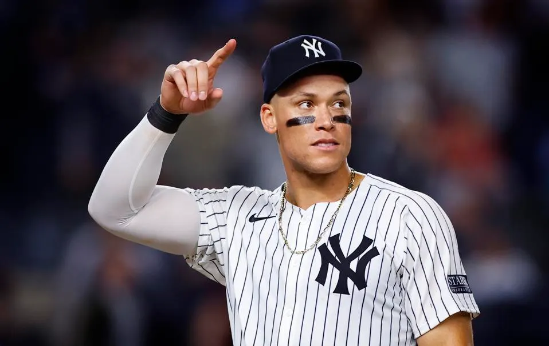
Notes:
Aaron Judge

Slide 26
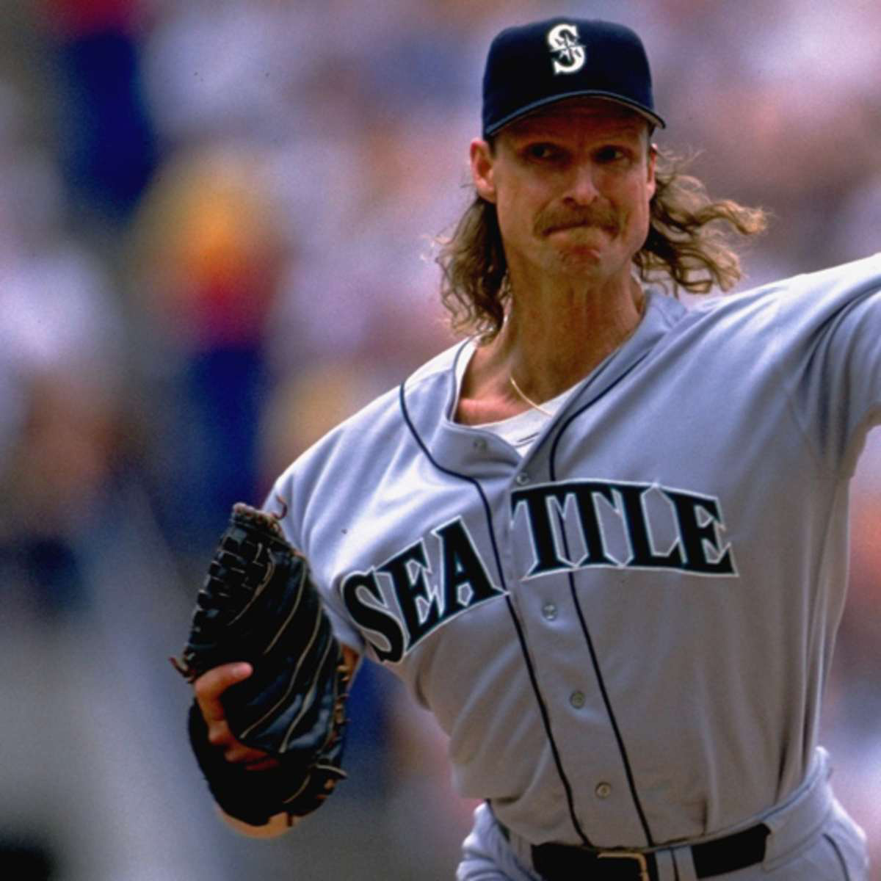
Notes:
Randy Johnson

Slide 27
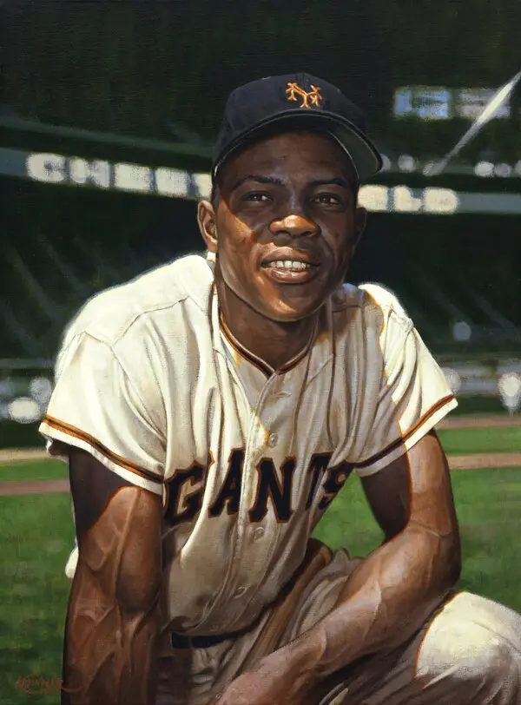
Notes:
Willie Mays

Slide 28
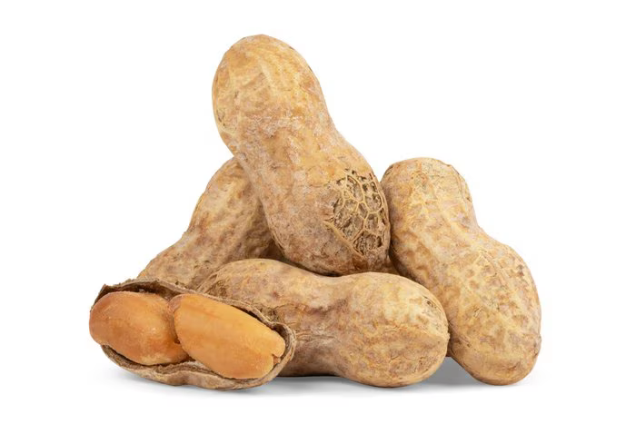
Notes:
Peanuts

Slide 29
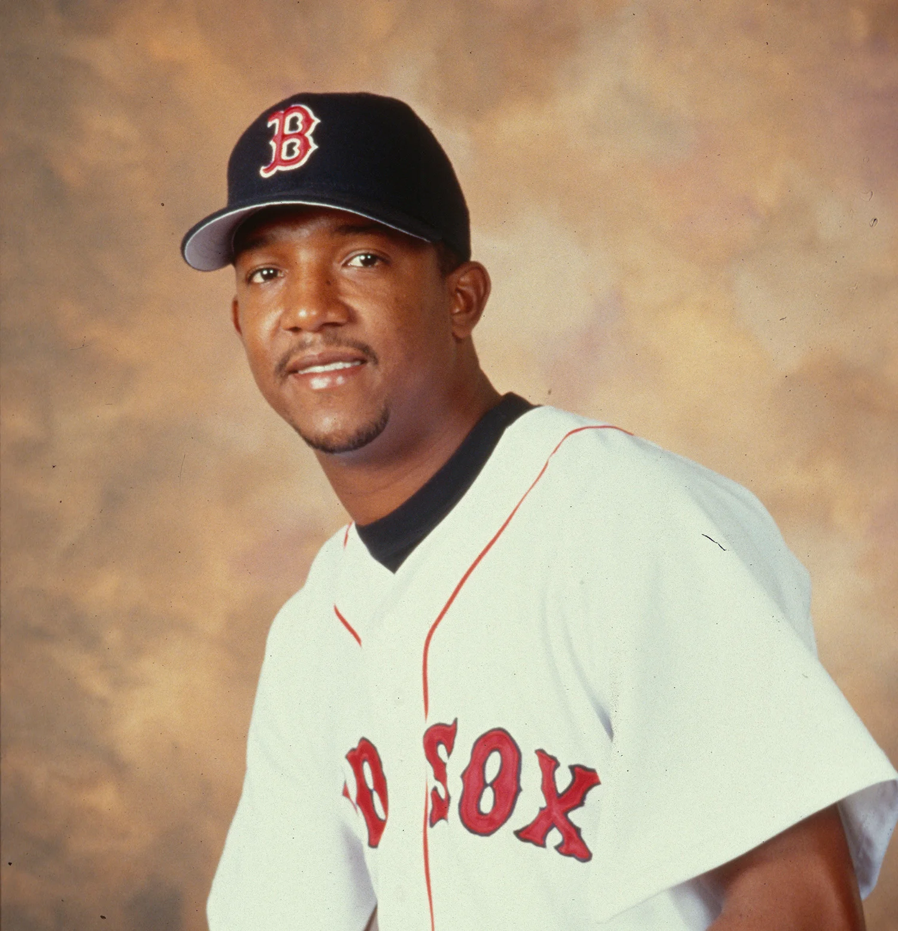
Notes:
Pedro Martinez

Slide 30
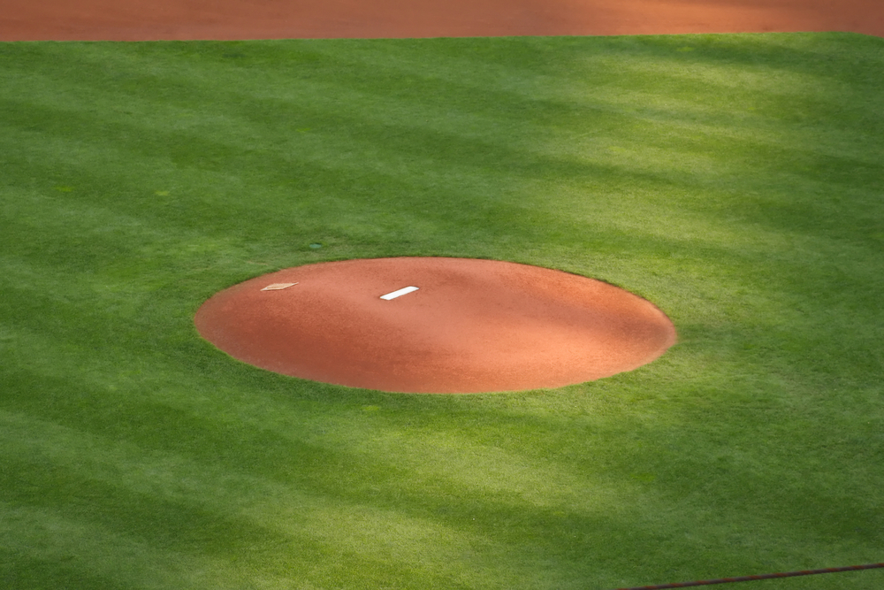
Notes:
Pitchers mound

Slide 31
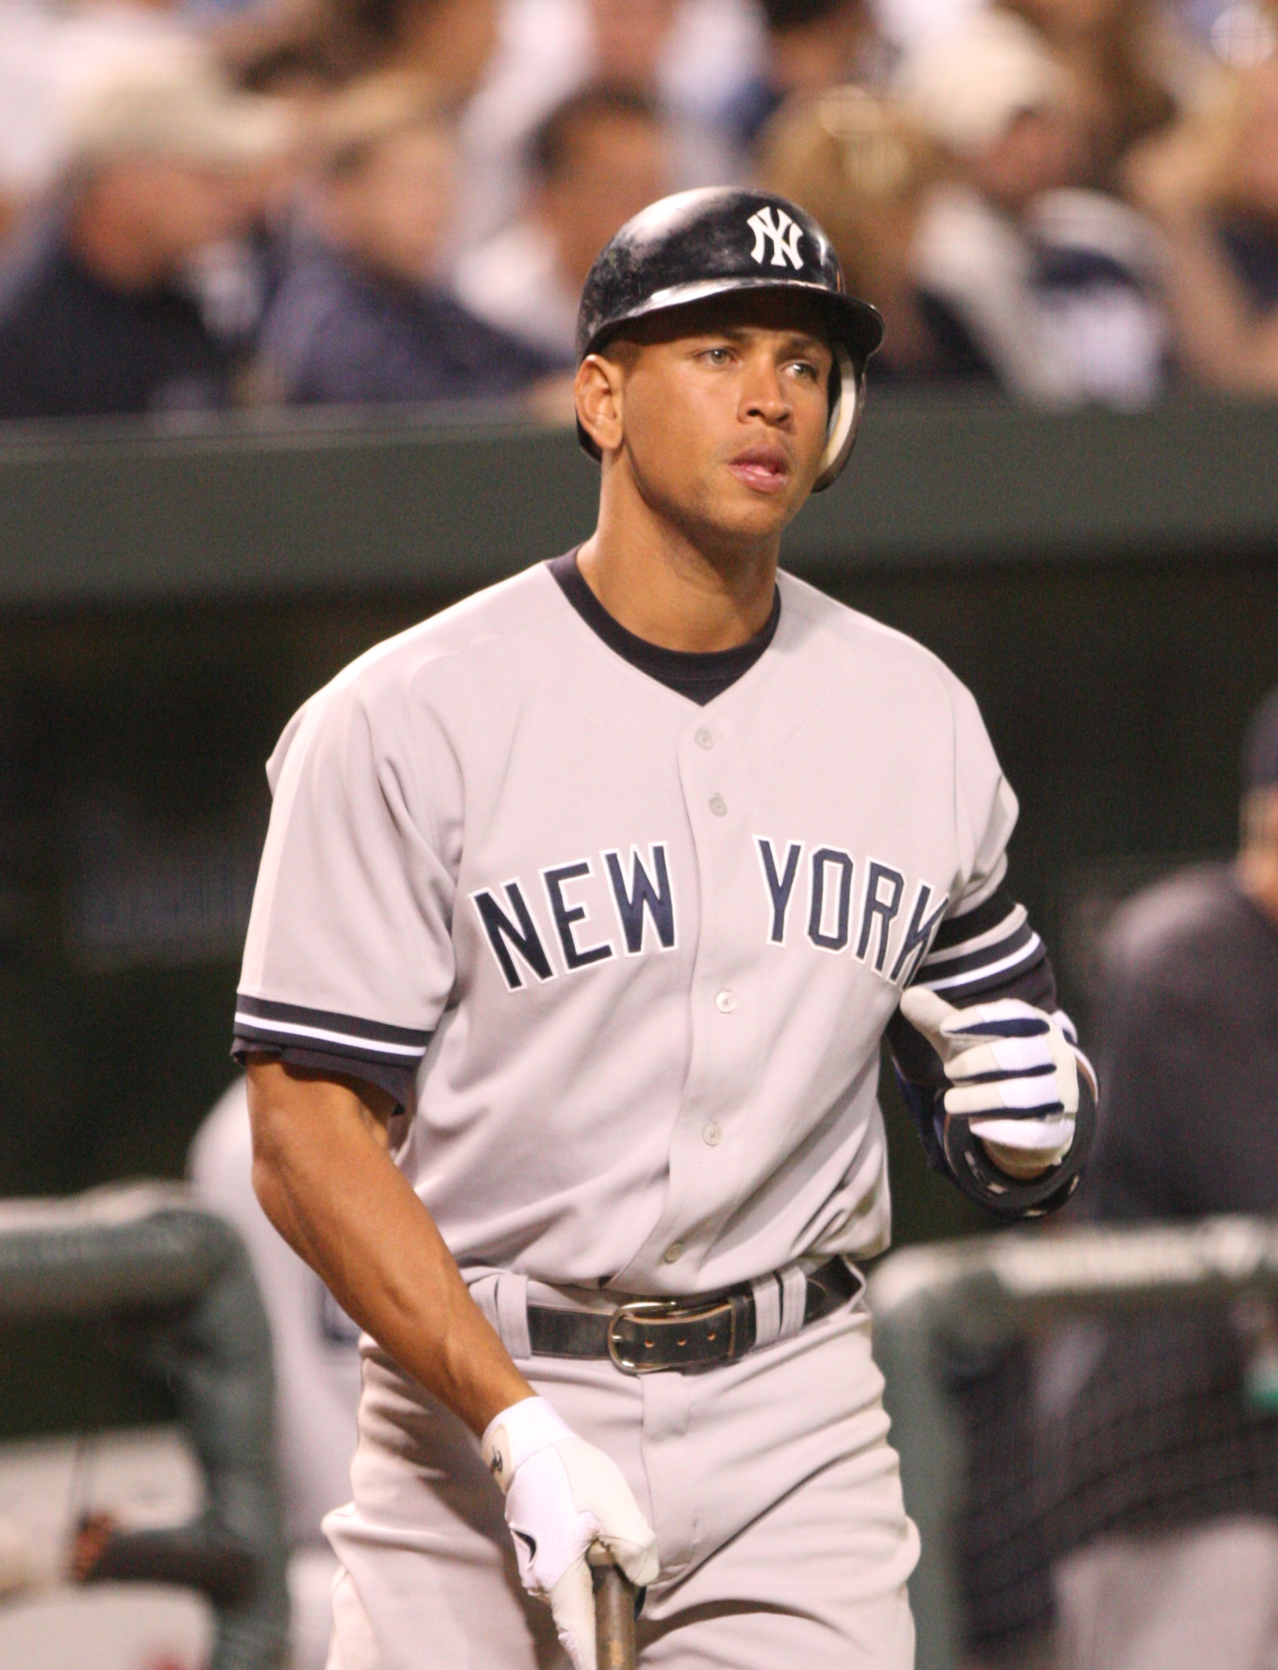
Notes:
Alex Rodriguez (A-Rod)

Slide 32
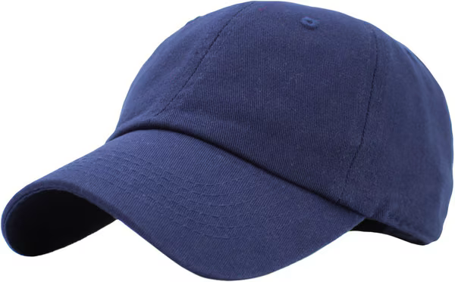
Notes:
Baseball cap

Slide 33

Notes:
Detroit Tigers

Slide 34
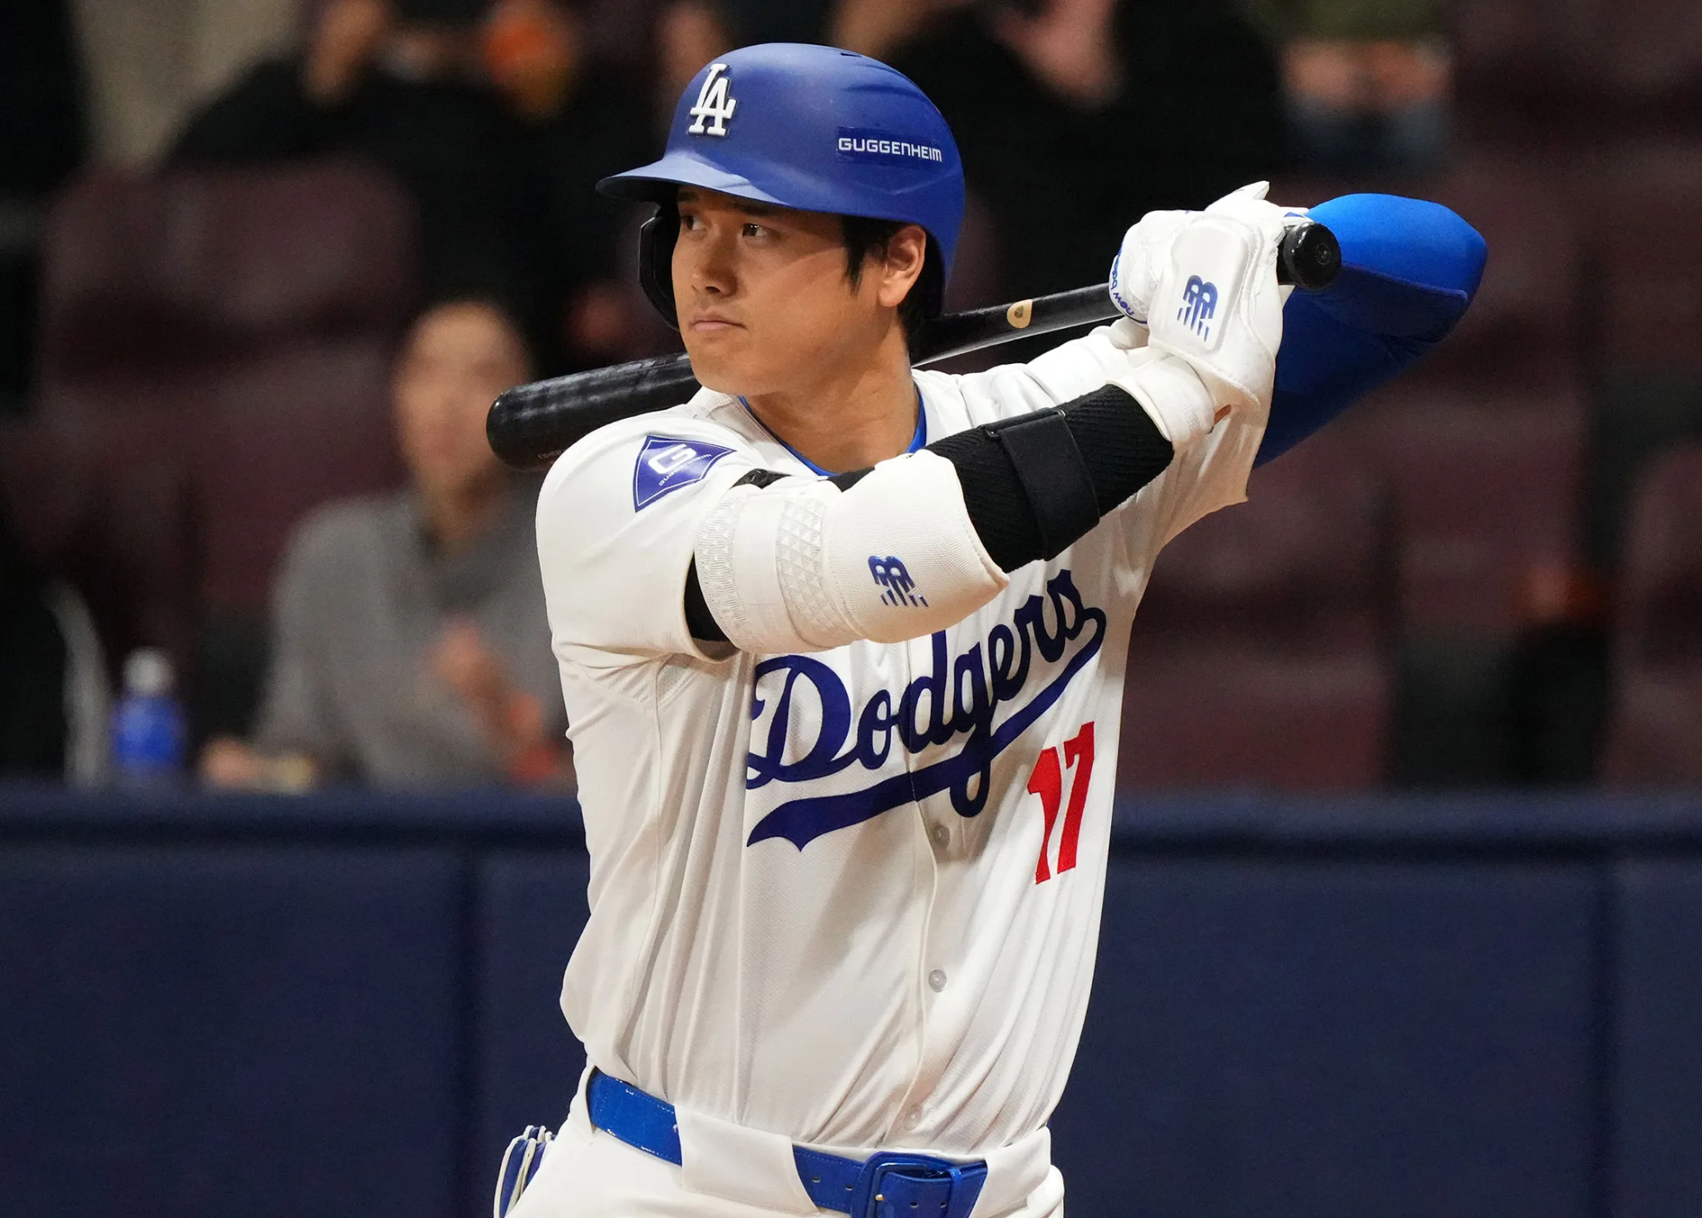
Notes:
Ohtani

Slide 35

Notes:
Cleveland Guardians

Slide 36
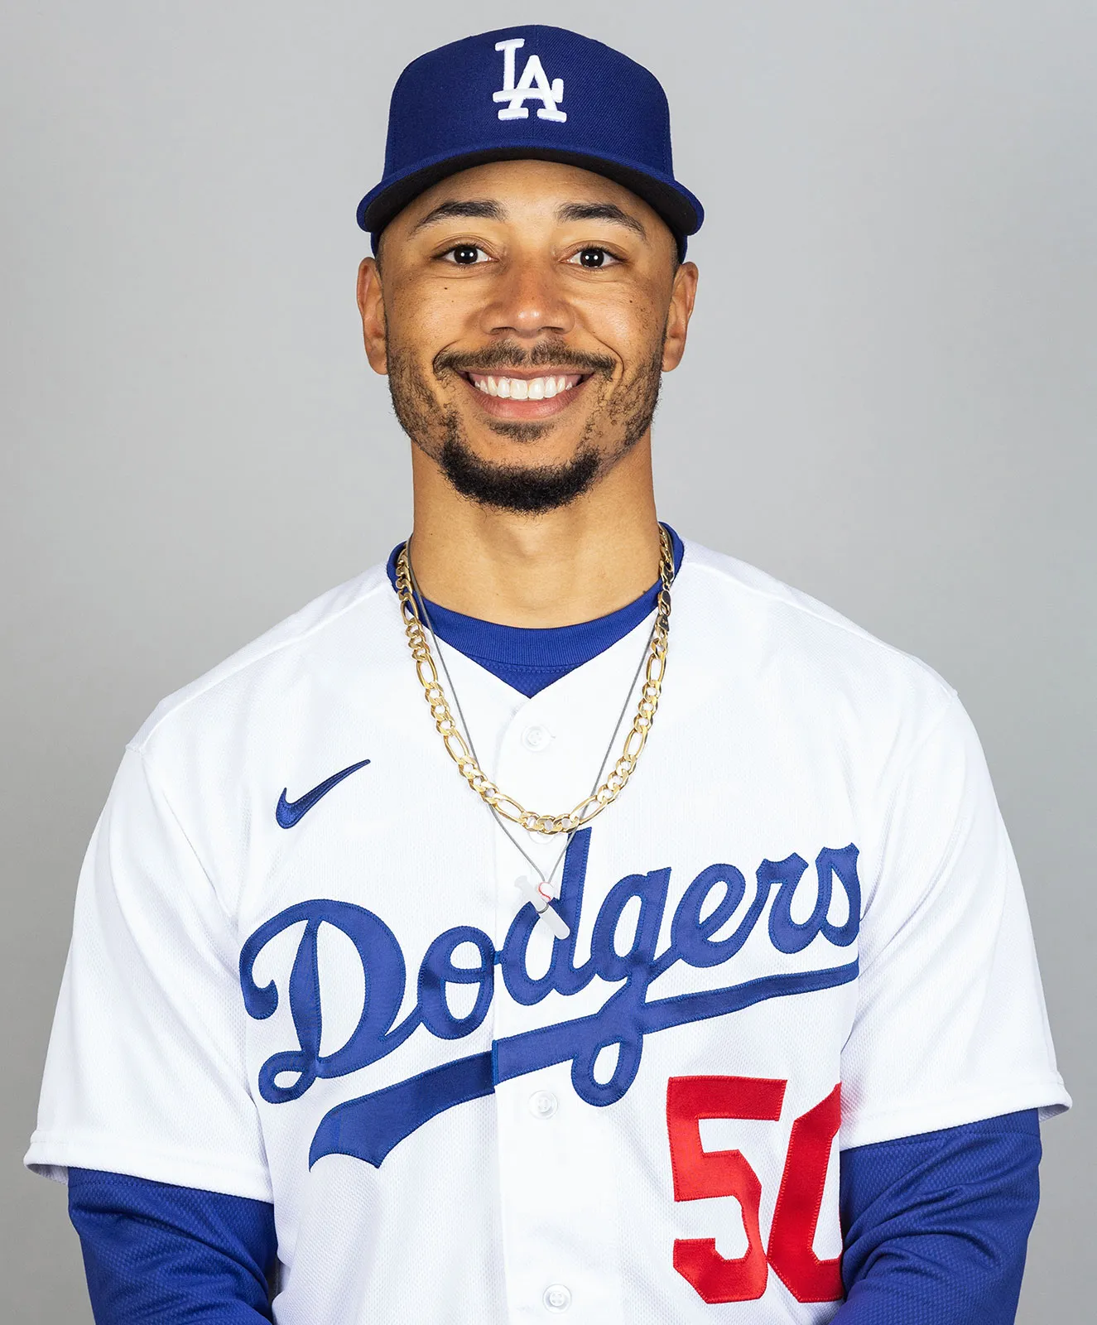
Notes:
Mookie Betts

Slide 37
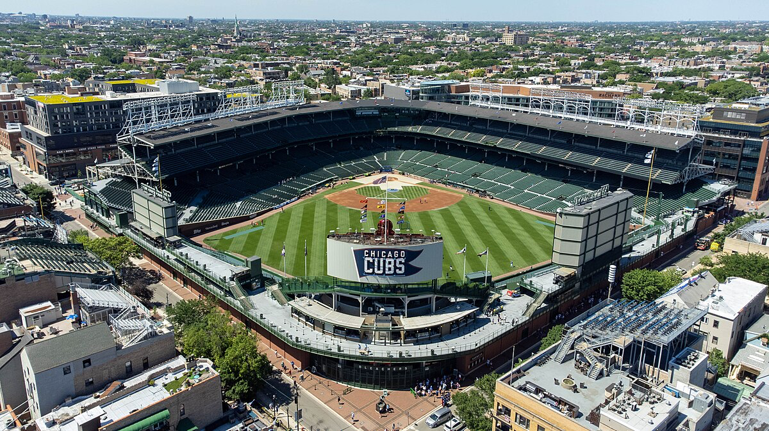
Notes:
Wrigley Field

Slide 38

Notes:
Colorado Rockies

Slide 39
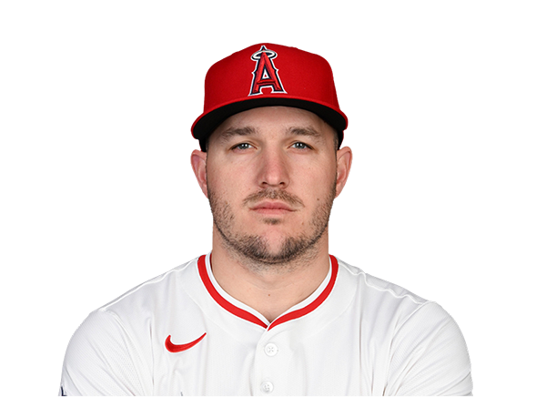
Notes:
Mike Trout

Slide 40
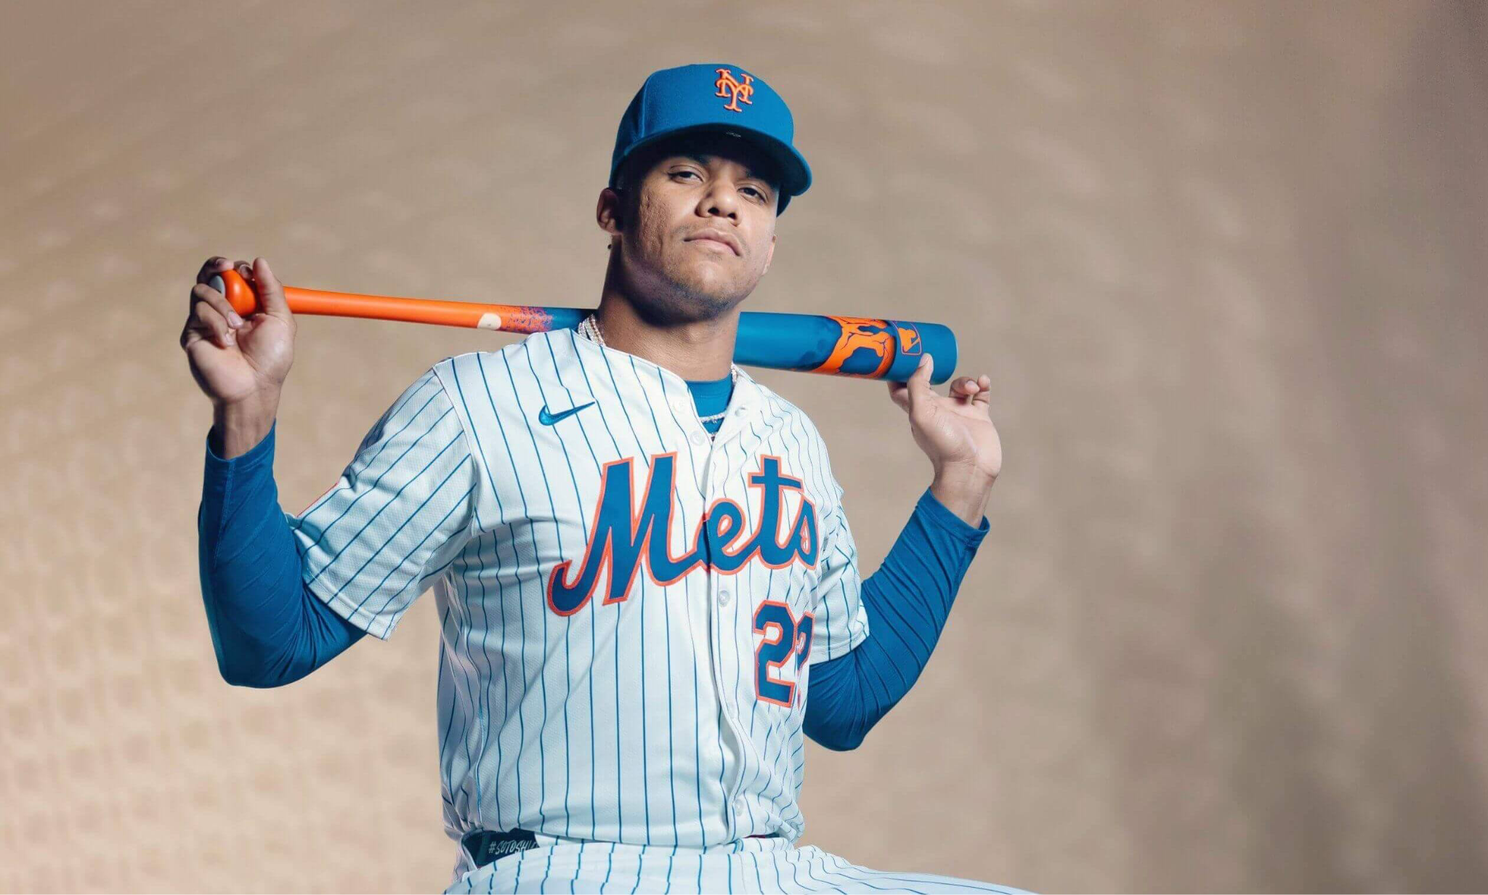
Notes:
Juan Soto

Slide 41
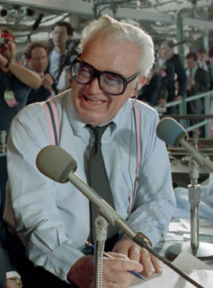
Notes:
Harry Caray

Slide 42
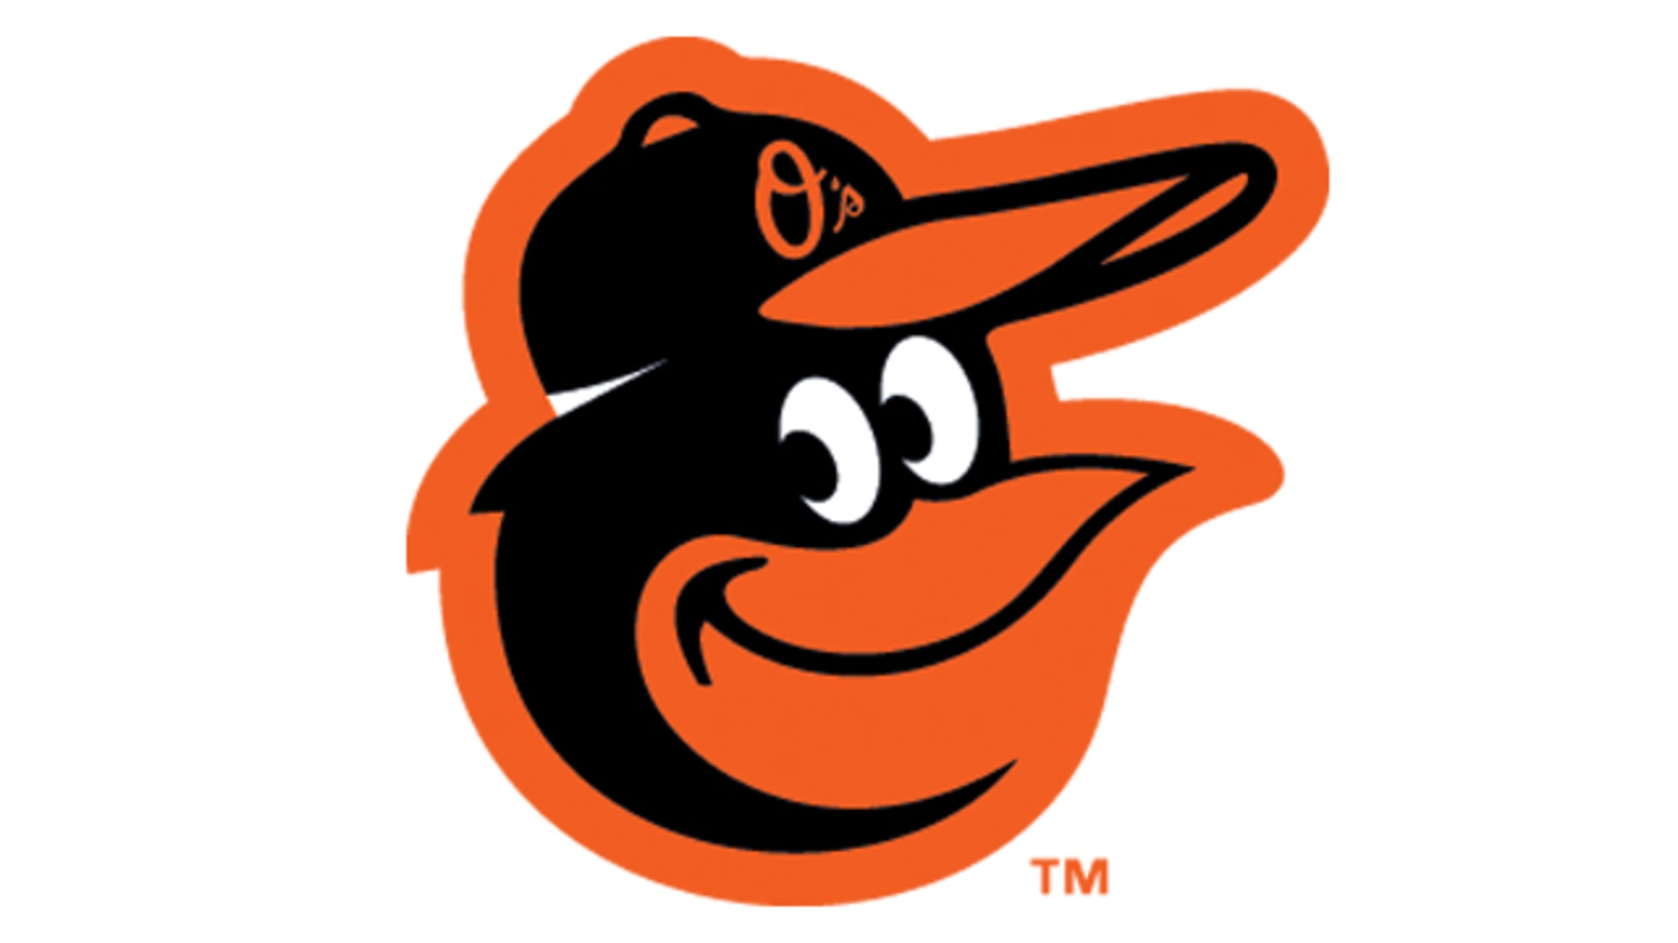
Notes:
Orioles

Slide 43
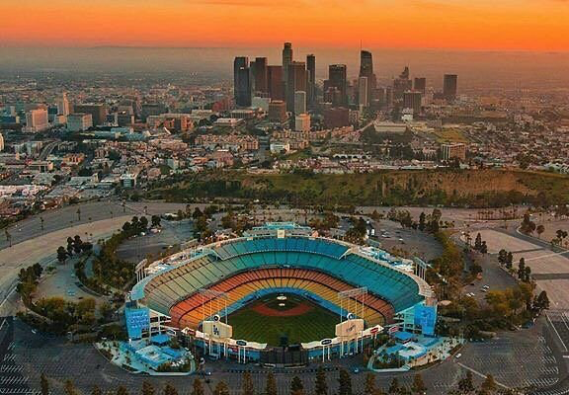
Notes:
Dodger Stadium

Slide 44
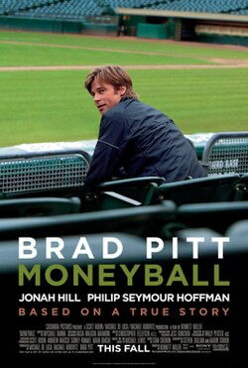
Notes:
Moneyball

Slide 45
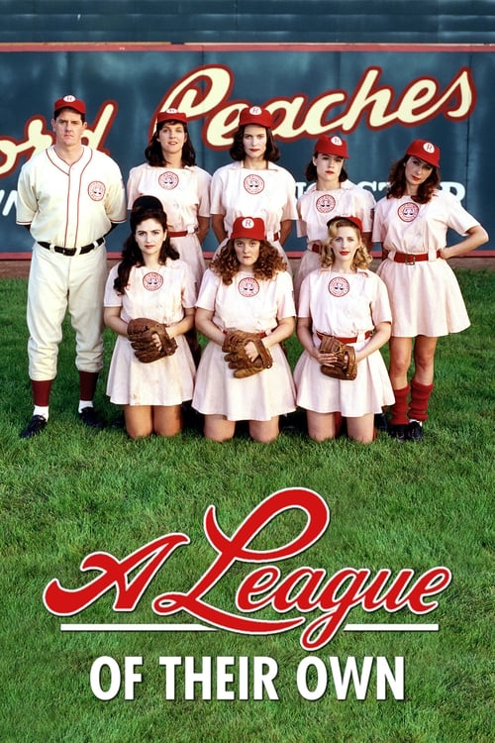
Notes:
A league of their own

Slide 46
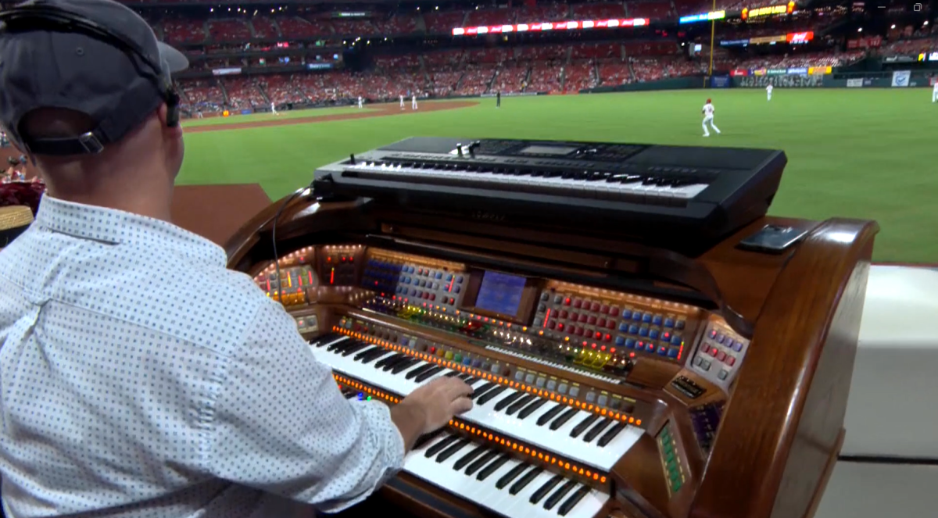
Notes:
Organ

Slide 47
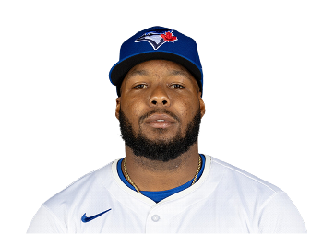
Notes:
Vladimir Guerrero

Slide 48
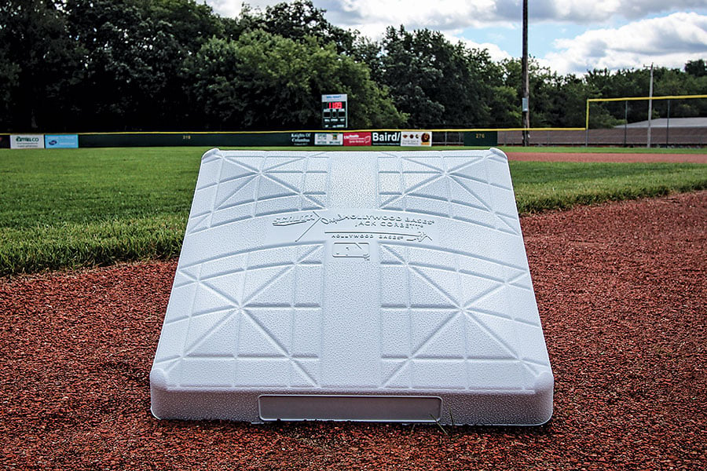
Notes:
base

Slide 49

Notes:
Milwaukee Brewers

Slide 50
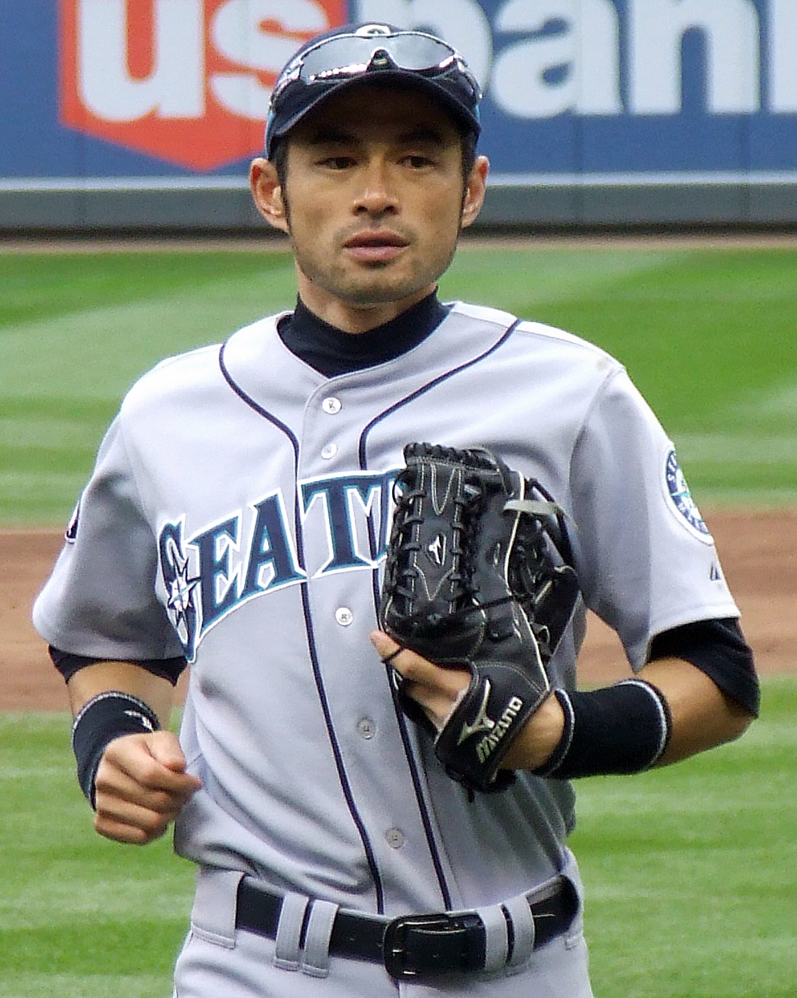
Notes:
Ichiro

